Slide 1

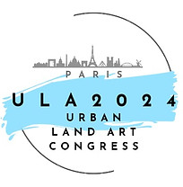

Paper Title
5th International Urban Landscape and Art Congress
(ULA 2024)
(October 25-27, 2022)
Authors,
University, Faculty and Department name
City and Country
Important notes:
The presentation's text should be written in English, while it can also be written in Turkish.
The presentation's primary headings should be considered. Short sentences should be used in texts.
The presentations are limited to a maximum of 15 minutes.

Slide 2
Title
Introduction:
Aim(s) of study:

Slide 3
Material and method
Material
Method

Slide 4
Results
Text

Slide 5
Conclusion

Slide 6
References

Slide 7
<<Thank you>> page
5th International Urban Landscape and Art Congress
(ULA 2024)
(October 25-27, 2022)
Add information here.

